Slide 1
Recap
What is accounting?
Language that businesses speak
Record, analyze, and communicate
Why is accounting useful?
Can make useful financial decisions (e.g., investing)

Slide 2
Technicalities
What is fundamental equation in accounting?
Asset = Liabilities + Owner’s Equity
Owner’s Equity = Contributed Capital + Retained Earnings
End RE = Beg RE + Net Income - Dividends

Slide 3
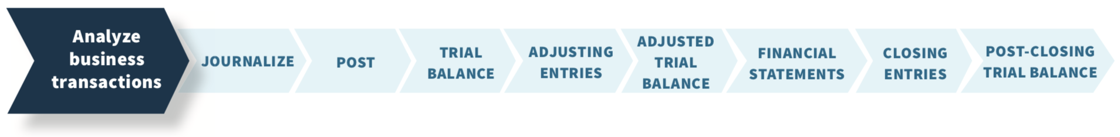
Accounting Cycle
Chapter 2
Chapter 1
During period
End of period
Chapter 3: End of the period
Chapter 4: End of the period
Notes:
Chap 1: How to analyze business transactions
Chap 2,3,4: How to record information and communicate information
Chap 2: How to record info! We have formal way of recording thins. We then make sure we did everything correctly using something called a “Trial balance” at end of period.
Chap 3: If we made any mistakes, now is our chance to fix. If there is additional information that we want to record, we do this. We communicate using financial statements
Chap 4: Then we finalize and get ready for next period.

Slide 4
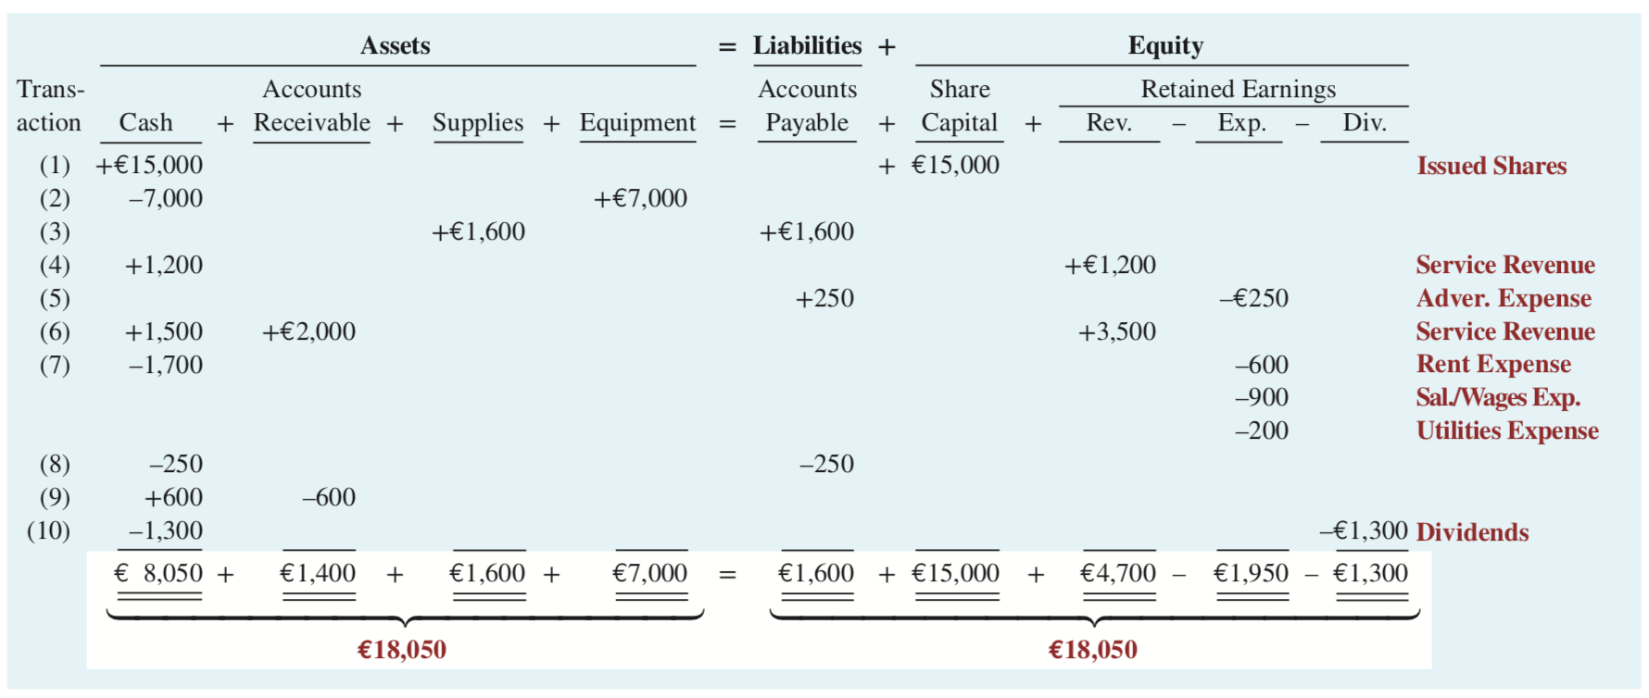
Tabular Summary
Illustration 1.10: Tabular summary of Softbyte SA transactions
L O 4
Notes:
Accounting equation balances because sometimes
Both RHS and LHS increase/decreas by same number
Only change on one side, but with different compositions
Transaction 2 → Cash down, Equipment up
In efficient and confusing. Cannot handle many transactions.

Slide 5
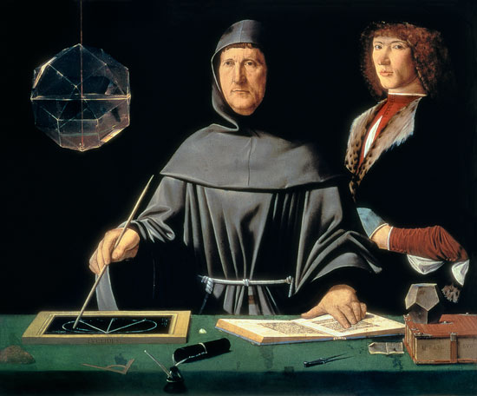
What is more efficient way to record?
Luca Pacioli (1447 – 1517)
Italian mathematician
Father of double-entry bookkeeping
Why do this?
Look at tabular summary, each transaction affects at least two accounts
If accounts are on different side, sum of both sides are same
If accounts are on same side, then the sum of the affected accounts are 0.
There are + and – signs in same column, which makes calculation tedious.

Slide 6
What did Luca do?
Use two columns for each account
One column for increase; Another column for decrease
Assets: Lets make two columns
Left for increase; Right for decrease
Liabilities/OE
Left for decrease; Right for increase
Why do this?
In this way, each transaction will have number recorded in the left and right column, with same amount on both sides

Slide 7
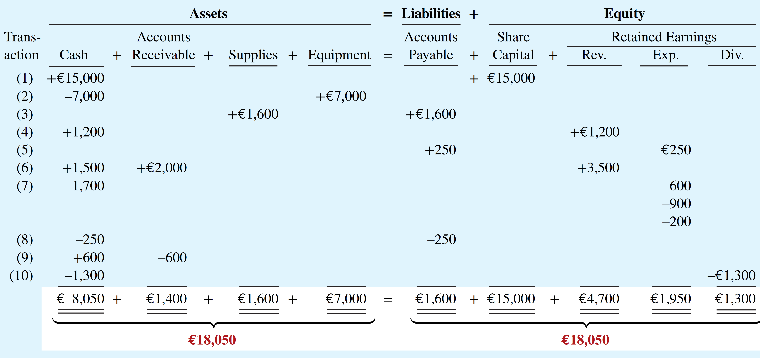
How it works – Cash & Share Capital
#
1
2
3
4
5
6
Account
Cash
Share Capital
Equipment
Cash
Supplies
Acc. Payable
Cash
Revenue
Expense
Acc. Payable
Cash
Acc. Receivable
Revenue
…
Left
15,000
7,000
1,600
1,200
250
1,500
2,000
Right
15,000
7,000
1,600
1,200
250
3,500
If accounting equation holds, each transaction has numbers recorded in the left and right columns, with the same amount on both sides!
Assets: Left for increase; Right for decrease
Liabilities/OE: Left for decrease; Right for increase
Notes:
How to write an entry: Debits on the top row; credits on the row beneath, with an indent in the beginning.

Slide 8
How it works – Cash & Equipment
#
1
2
3
4
5
6
Account
Cash
Share Capital
Equipment
Cash
Supplies
Acc. Payable
Cash
Revenue
Expense
Acc. Payable
Cash
Acc. Receivable
Revenue
…
Left
15,000
7,000
1,600
1,200
250
1,500
2,000
Right
15,000
7,000
1,600
1,200
250
3,500
If accounting equation holds, each transaction has numbers recorded in the left and right columns, with the same amount on both sides!
Assets: Left for increase; Right for decrease
Liabilities/OE: Left for decrease; Right for increase

Slide 9
Better names for “left” and “right”
#
1
2
3
4
5
6
Account
Cash
Share Capital
Equipment
Cash
Supplies
Acc. Payable
Cash
Revenue
Expense
Acc. Payable
Cash
Acc. Receivable
Revenue
…
Debit
15,000
7,000
1,600
1,200
250
1,500
2,000
Credit
15,000
7,000
1,600
1,200
250
3,500
Left（×）
Debit（√）
Right（×）
Credit（√）
Notes:
Asset → Debit, left, increase
Liabilities → Credit, Right increase
Owner’s Equity → Credit, Right, increase

Slide 10
Financial Accounting
IFRS 5th Edition
Weygandt ● Kimmel
Chapter 2
The Recording Process
This slide deck contains animations. Please disable animations if they cause issues with your device.
Copyright © John Wiley & Sons, Inc.

Slide 11
Chapter Outline
Learning Objectives
LO 1 Describe how accounts, debits, and credits are used to record business transactions.
LO 2 Indicated how a journal is used in the recording process.
LO 3 Explain how a ledger and posting help in the recording process.
LO 4 Prepare a trial balance.

Slide 12
Learning Objective 1 Describe how accounts, debits, and credits are used to record business transactions.
L O 1

Slide 13
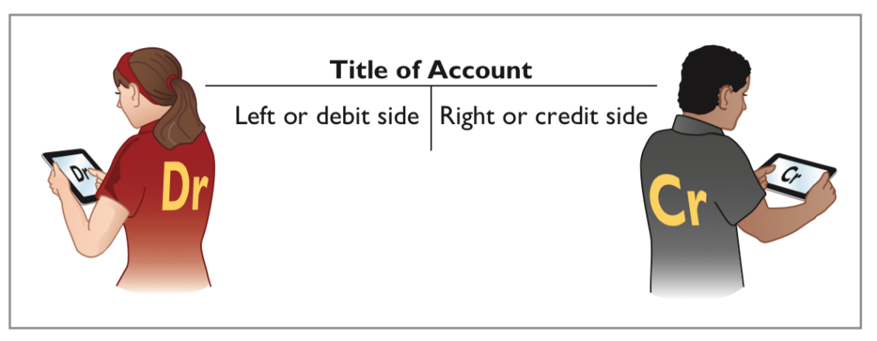
Accounts, Debits, and Credits
The Account
An account is an individual accounting record of increases and decreases in a specific asset, liability, or equity item.
In its simplest form, an account consists of three parts:
(1) a title, (2) a left or debit side (Dr.), and (3) a right or credit side (Cr.).
Illustration 2.1: Basic form of account
Note: Whenever we are referring to a specific account, we capitalize the name.
L O 1

Slide 14
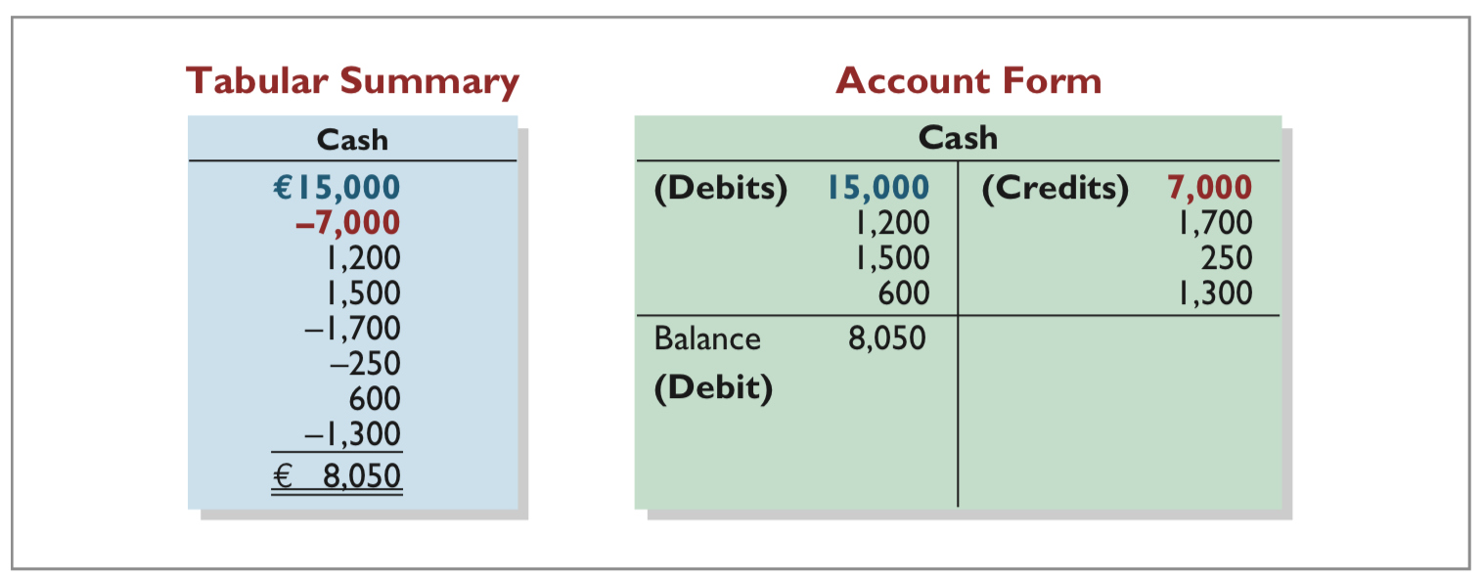
Debits and Credits
Tabular Summary (Chapter 1) and Account Form (this Chapter)
Illustration 2.2: Tabular summary and account form for Softbyte’s Cash account
L O 1

Slide 15
Dr./Cr. Procedures for Assets and Liabilities
Debits | Credits
Increase assets | Decrease assets
Decrease liabilities | Increase liabilities
Illustration 2.3: Debit and credit effects─ assets and liabilities
Increases in cash (an asset) are entered on the left side and decreases in cash are entered on the right side
Both sides of the basic equation (Assets = Liabilities + Equity) must be equal.
Increases and decreases in liabilities have to be recorded opposite from increases and decreases in assets.
Thus, increases in liabilities are entered on the right or credit side, and decreases in liabilities are entered on the left or debit side.
L O 1

Slide 16
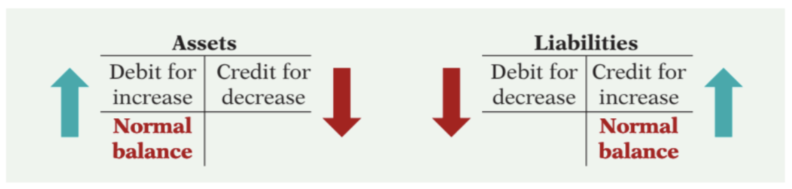
Normal Balances - Assets and Liabilities
Illustration 2.4: Normal balances─ assets and liabilities
Asset accounts normally show debit balances. That is, debits to a specific asset account should exceed credits to that account.
Liability accounts normally show credit balances. That is, credits to a liability account should exceed debits to that account.
L O 1

Slide 17

Normal Balance - Equity
Share Capital—Ordinary.
Illustration 2.6: Normal balance─ share capital─ ordinary
Knowing the normal balance in an account may help you trace errors.
Occasionally, though, an abnormal balance may be correct.
The cash account, for example, will have a credit balance when a company has overdrawn its bank balance.
L O 1

Slide 18
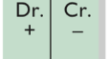
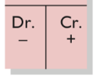
Summary of Debit/Credit Rules
Asset = Liability + Equity → CC & RE
Income = Revenue - Expense - Dividend
L O 1
Notes:
If expenses go up, it decreases equity… so should have opposite sign
If dividends go up, it decreases equity… so should have opposite sign

Slide 19
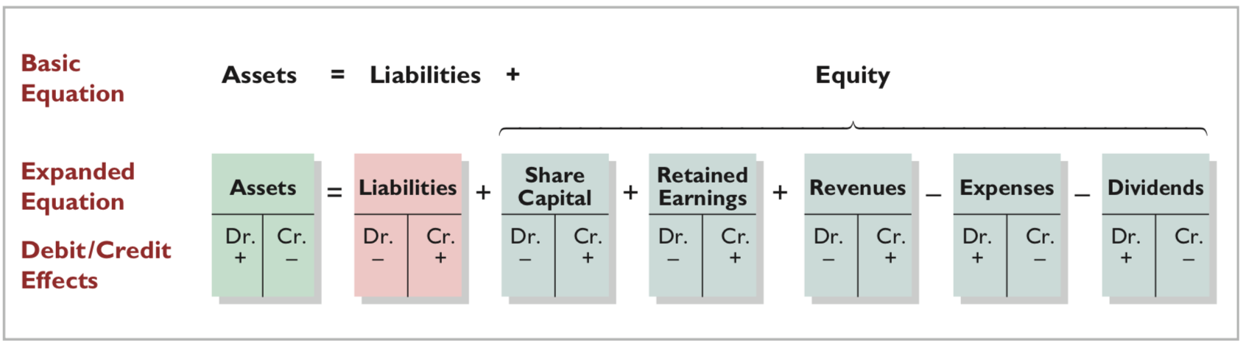

Slide 20
Example 1
You invest $1000 to open a chocolate store on campus.
Cash + Acct Receivable = Liability + RE + Contributed capital
+1000 +1000
DR CR
Cash 1000
Contr. Cap. 1000

Slide 21
Example 2
Your chocolate store sold $500 dollar chocolate to a customer on Sept 1, 2023, the customer paid the cash on the same day.
Cash + Acct Receivable = Liability + Equity
+500 +500 (Rev)
DR CR
Cash 500
Revenue 500

Slide 22
Example 3
You pays $300 rent in cash
Cash + Acct Receivable = Liability + RE + Contributed capital
-300 -300 (Exp)
DR CR
Expense 300
Cash 300
Note: cash decreases, so it is a credit on cash account
Expense increase, so it is a debit account (reduces equity)

Slide 23
Example 4
Your chocolate store pays $50 cash dividend
Cash + Acct Receivable = Liability + RE + Contributed capital
-50 -50 (Div)
DR CR
Dividend 50
Cash 50
Note: cash decreases, so it is a credit on cash account
Expense increase, so it is a debit account (reduces equity)

Slide 24
DO IT! 1: Normal Account Balances
Julie Loeng has just rented space in a shopping mall. In this space, she will open a hair salon to be called “Hair It Is.” A friend has advised Julie to set up a double-entry set of accounting records in which to record all of her business transactions.
Identify the statement of financial position accounts that Julie will likely need to record the transactions needed to open her business. Indicate whether the normal balance of each account is a debit or a credit.
L O 1

Slide 25
DO IT! 1: Normal Account Balances – Solution
Julie would likely need the following accounts in which to record the transactions necessary to ready her hair salon for opening day:
Cash (debit balance) Equipment (debit balance)
Supplies (debit balance)
Accounts Payable (credit balance)
If she borrows money:
Notes Payable (credit balance)
If she invests cash:
Share Capital—Ordinary (credit balance)
L O 1

Slide 26
Learning Objective 2 Indicate how a journal is used in the recording process.
L O 2

Slide 27
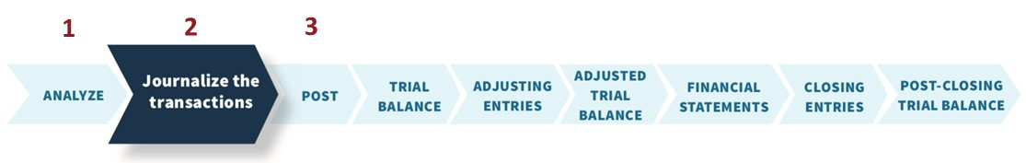
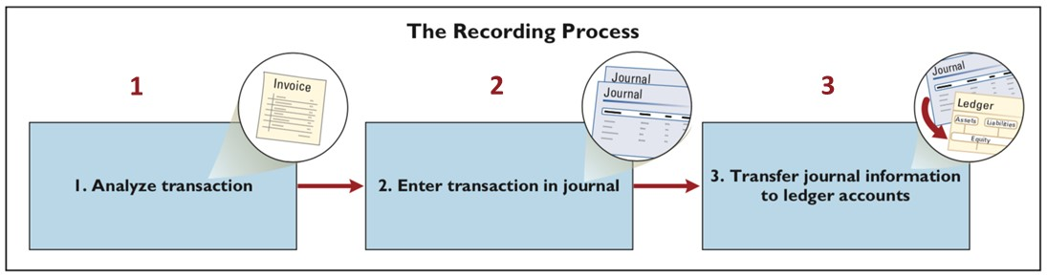
The Recording Process Illustrated
Illustration 2.13: The recording process
L O 2

Slide 28
The Journal
Companies initially record transactions in chronological order. Thus, the journal is referred to as the book of original entry.
The journal makes several significant contributions to the recording process:
It discloses in one place the complete effects of a transaction.
It provides a chronological record of transactions.
It helps to prevent or locate errors because the debit and credit amounts for each entry can be easily compared.
L O 2

Slide 29
Journalizing
Assume: On September 1, Softbyte SA shareholders invested €15,000 cash in the corporation in exchange for ordinary shares, and Softbyte purchased computer equipment for €7,000 cash.
Demonstrate: How do you enter the transaction data in the journal?
L O 2

Slide 30
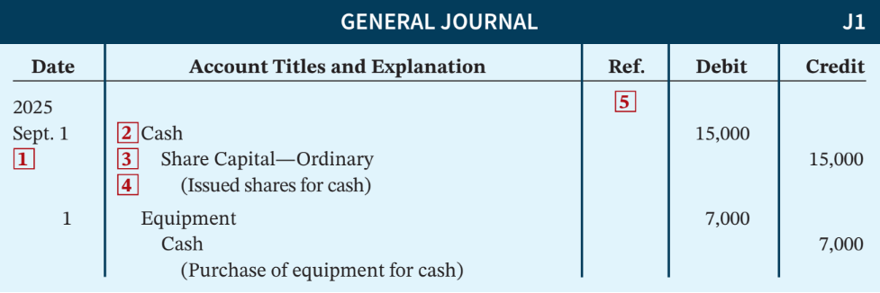
Journalizing Illustration
Illustration 2.14: Techniques of journalizing
Date of the transaction.
Debit account title.
Credit account title.
Brief explanation of the transaction.
Reference column, which is left blank when the journal entry is made. This column is used later when the journal entries are transferred to the individual accounts.
L O 2

Slide 31
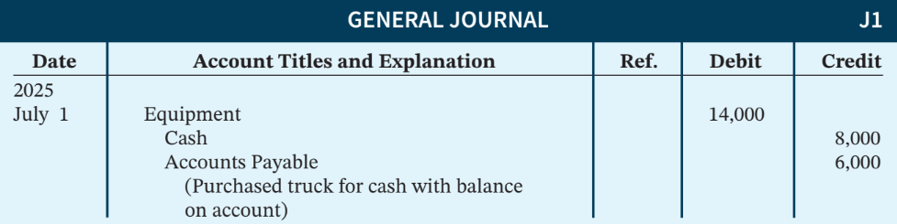
Simple and Compound Entries
Simple entry: Involves one debit and one credit account.
Compound entry: An entry that requires three or more accounts. The standard format requires that all debits be listed before the credits.
Illustration 2.15: Compound journal entry
L O 2

Slide 32
DO IT! 2: Recording Business Activities
As president and sole shareholder, Julie Loeng engaged in the following activities in establishing her beauty salon, Hair It Is.
Opened a bank account in the name of Hair It Is and deposited €20,000 of her own money in this account in exchange for ordinary shares.
Purchased equipment on account (to be paid in 30 days) for a total cost of €4,800.
Interviewed three applicants for the position of beautician.
In what form (type of record) should Hair It Is record these three activities? Prepare the entries to record the transactions.
L O 2

Slide 33
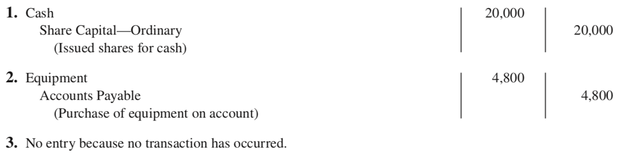
DO IT! 2: Recording Business Activities– Solution
Each transaction that is recorded is entered in the general journal. The three activities would be recorded as follows.
L O 2

Slide 34
Learning Objective 3 Explain how a ledger and posting help in the recording process.
L O 3

Slide 35
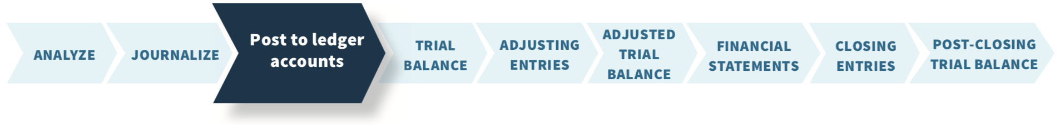
The Ledger and Posting
Ledger: The entire group of accounts maintained by a company.
Provides the balance in each of the accounts as well as keeps track of changes in these balances.
Companies may use various kinds of ledgers, but every company has a general ledger.
L O 3

Slide 36
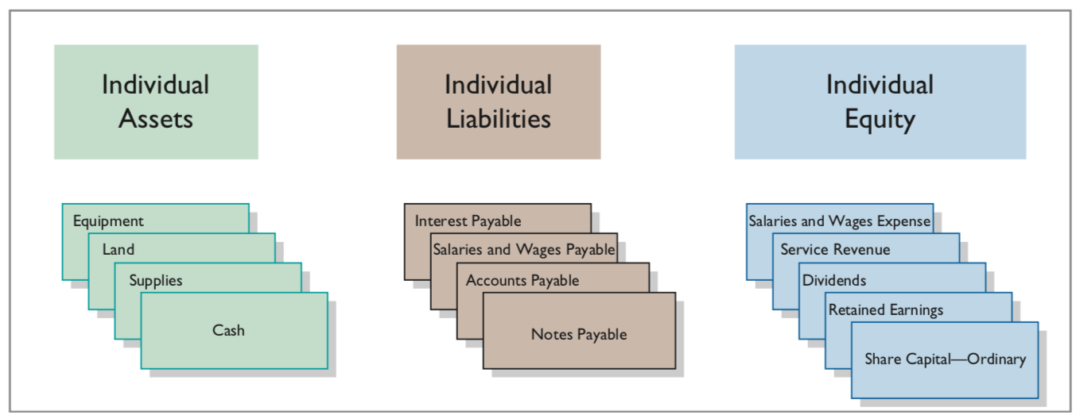
The Ledger
The General Ledger
Illustration 2.16: The general ledger, which contains all of a company’s accounts
L O 3

Slide 37
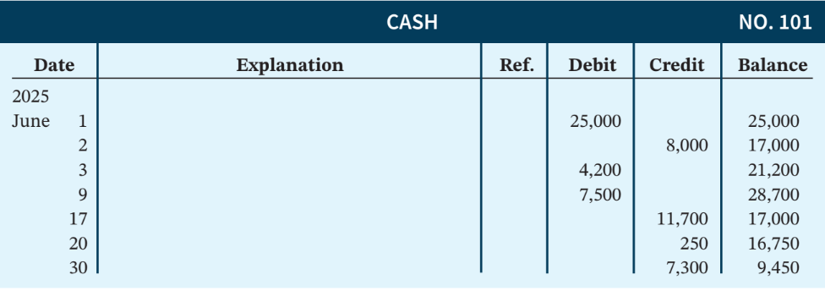
Cash Account
Illustration 2.17: Three-column form of account
This format is called the three-column form of account. It has three money columns—debit, credit, and balance.
L O 3

Slide 38
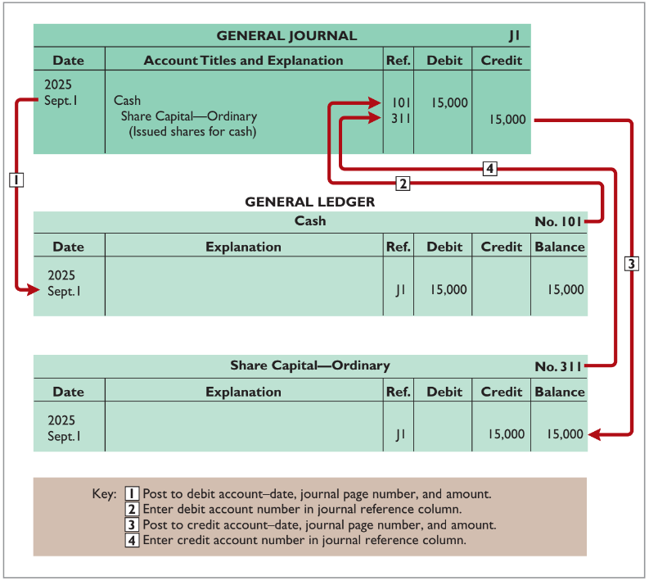
Posting
Illustration 2.18: Posting a journal entry
L O 3

Slide 39
The Recording Process Illustrated
October transactions of Yazici Advertising A.Ş. Accounting period: One month
HELPFUL HINT
Follow these steps: 1 - Determine what type of account is involved. 2 - Determine what items increased or decreased and by how much. 3 - Translate the increases and decreases into debits and credits.
L O 3

Slide 40
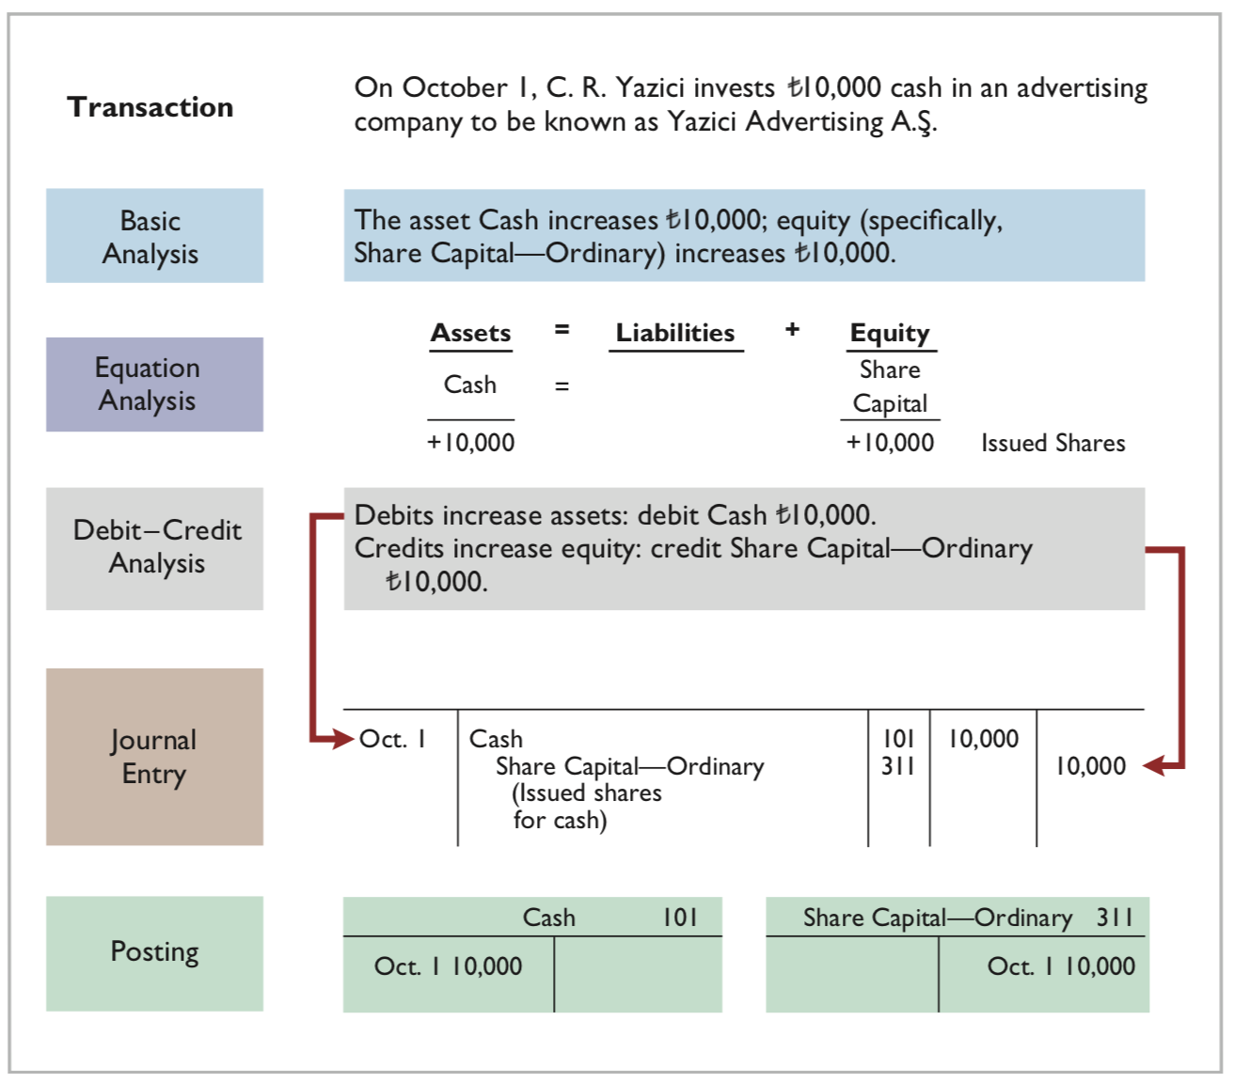
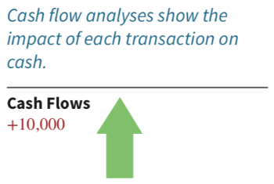
Investment of Cash
Illustration 2.20: Investment of cash by shareholders
L O 3

Slide 41
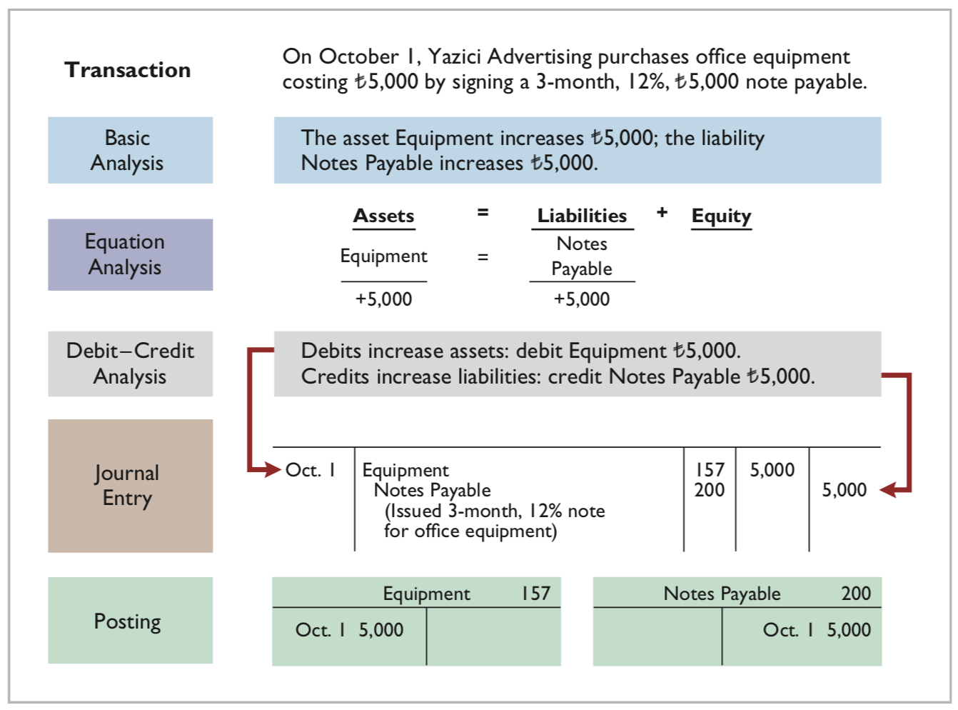

Purchase of Office Equipment
Illustration 2.21: Purchase of office equipment
L O 3

Slide 42
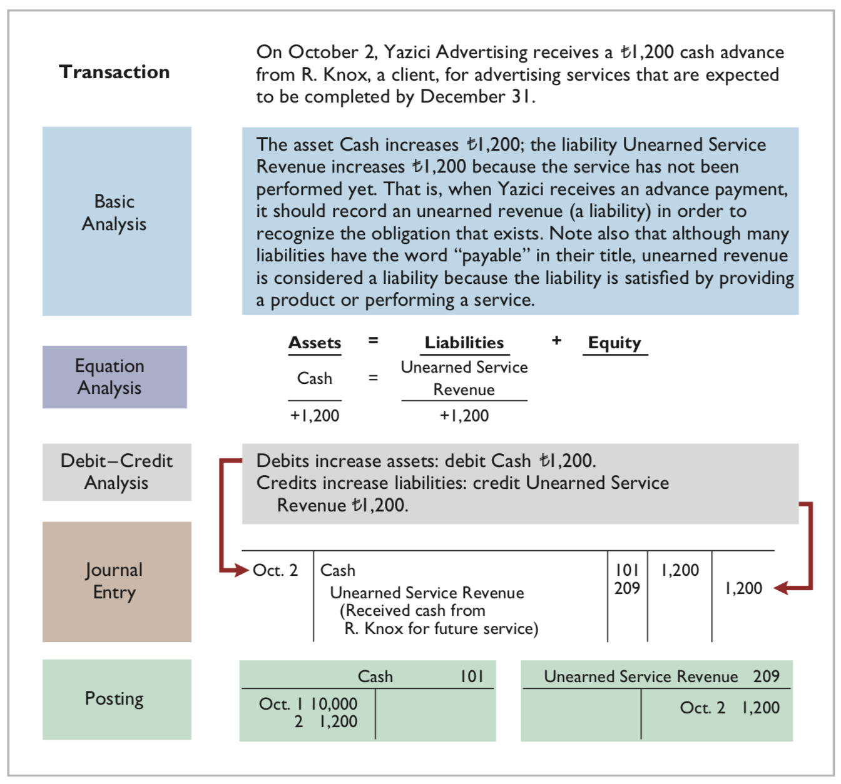
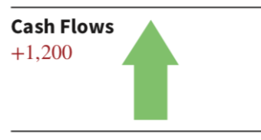
Receipt of Cash for Future Service
Unearned Service Revenue is considered a liability even though the word payable is not used.
Illustration 2.22: Receipt of cash for future service
L O 3
Notes:
Got cash but have not yet earned it (i.e., have not yet performed action that gets me the cash). This is unearned revenue and is a liability. Company owes service.

Slide 43
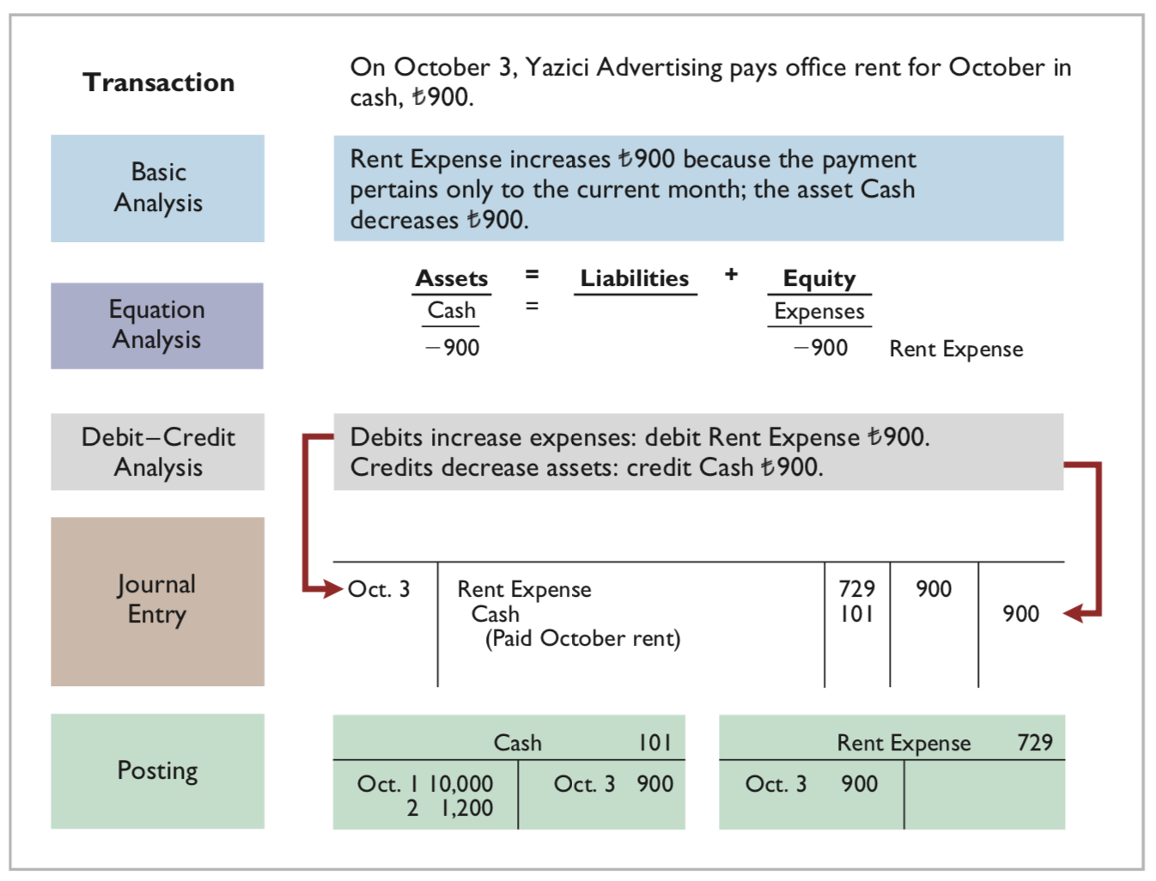

Payment of Monthly Rent
Illustration 2.23: Payment of monthly rent
L O 3

Slide 44
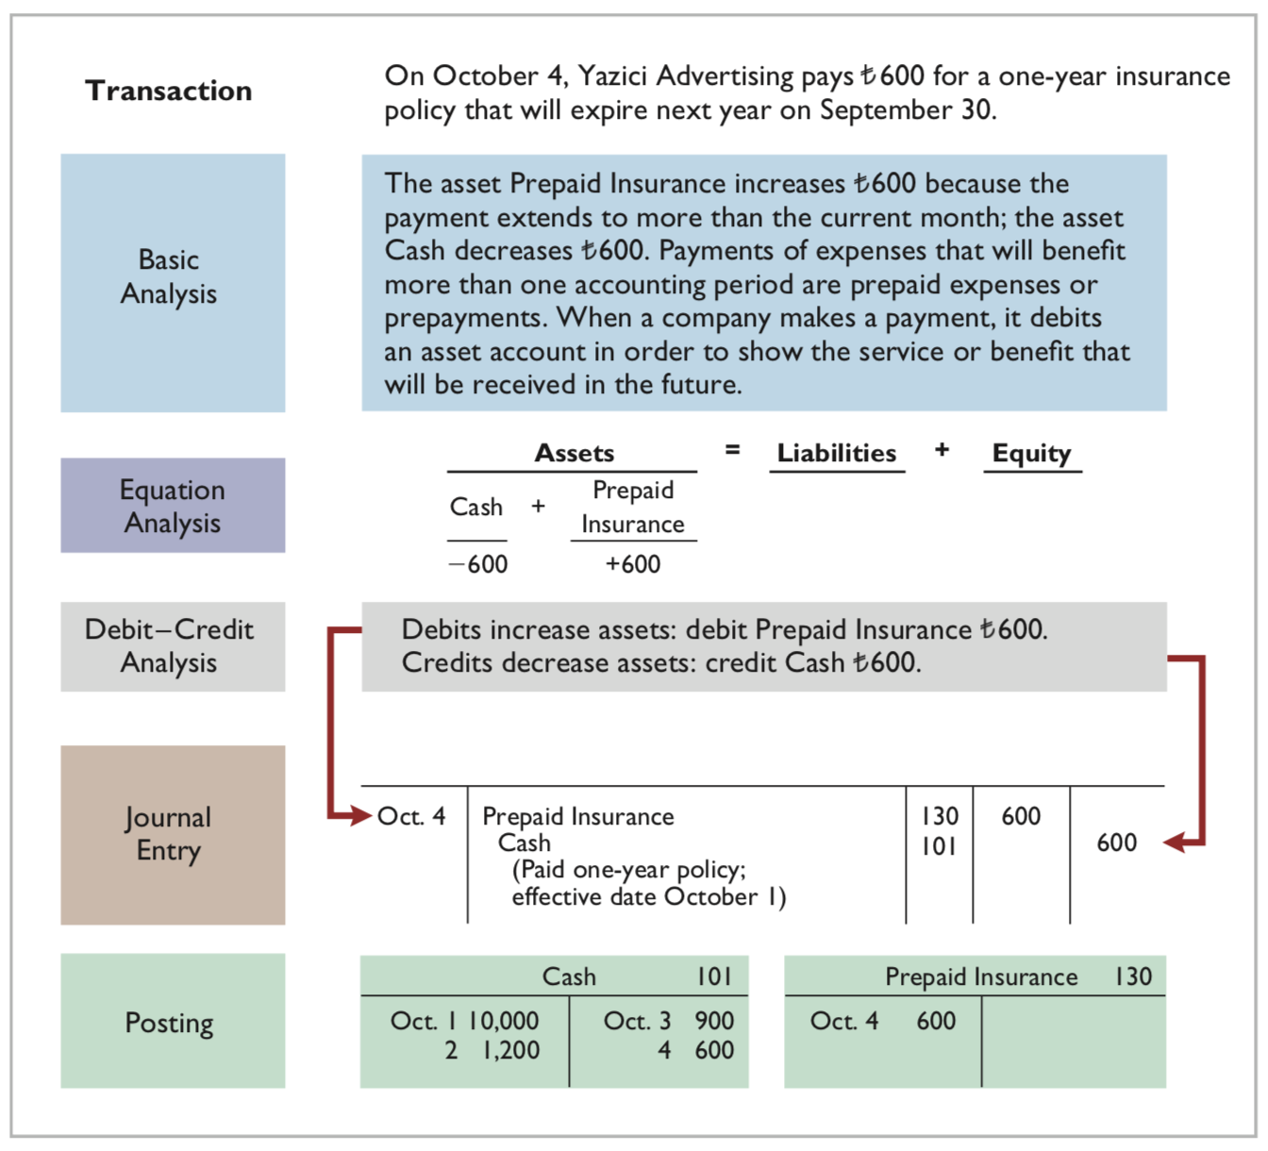
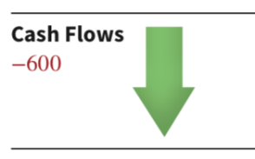
Payment for Insurance
Illustration 2.24: Payment for insurance
L O 3

Slide 45
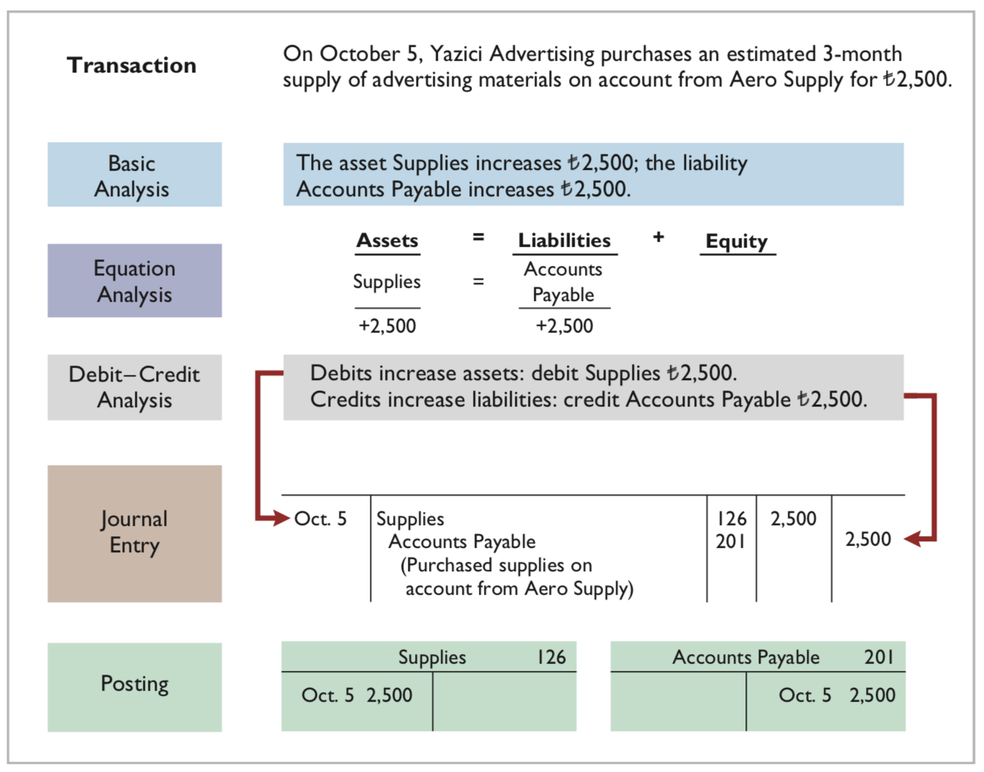
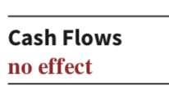
Purchase of Supplies on Credit
Illustration 2.25: Purchase of supplies on credit
L O 3

Slide 46
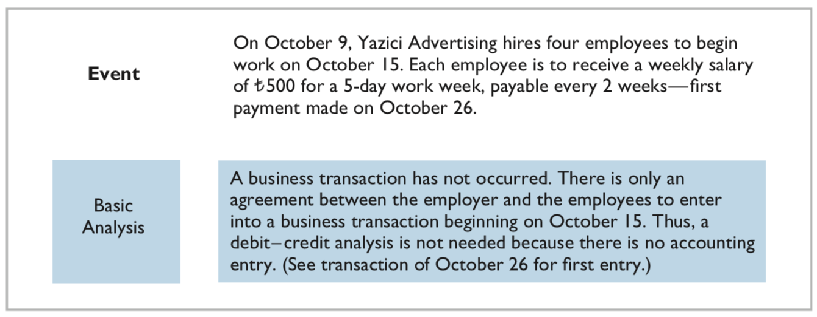
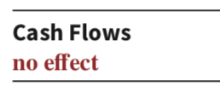
Hiring of Employees
Illustration 2.26: Hiring of employees
L O 3

Slide 47
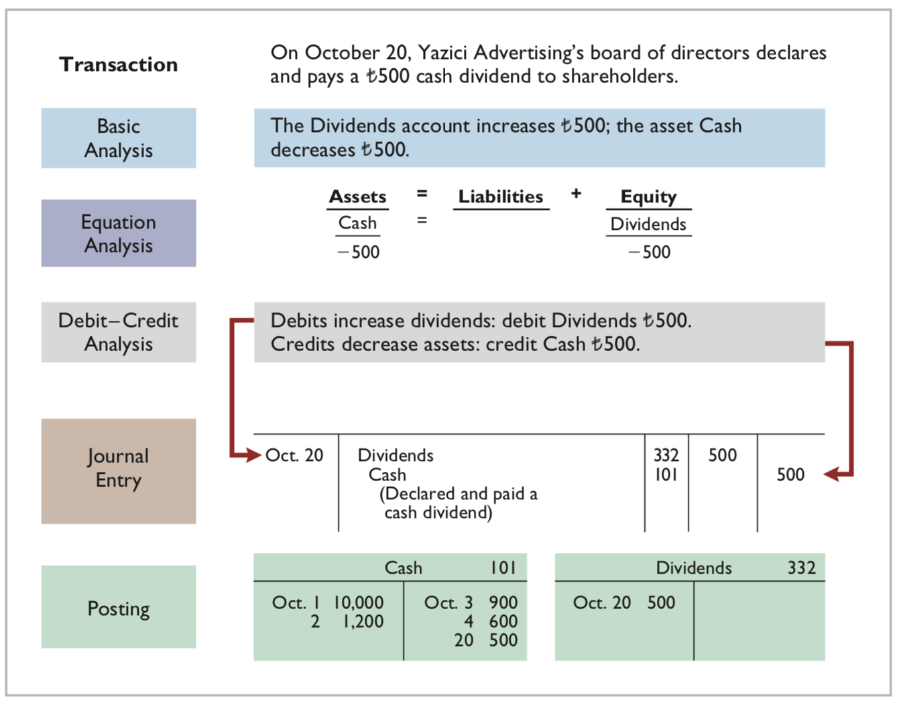
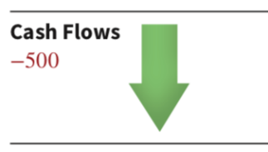
Declaration and Payment of Dividend
Illustration 2.27: Declaration and payment of dividend
L O 3

Slide 48
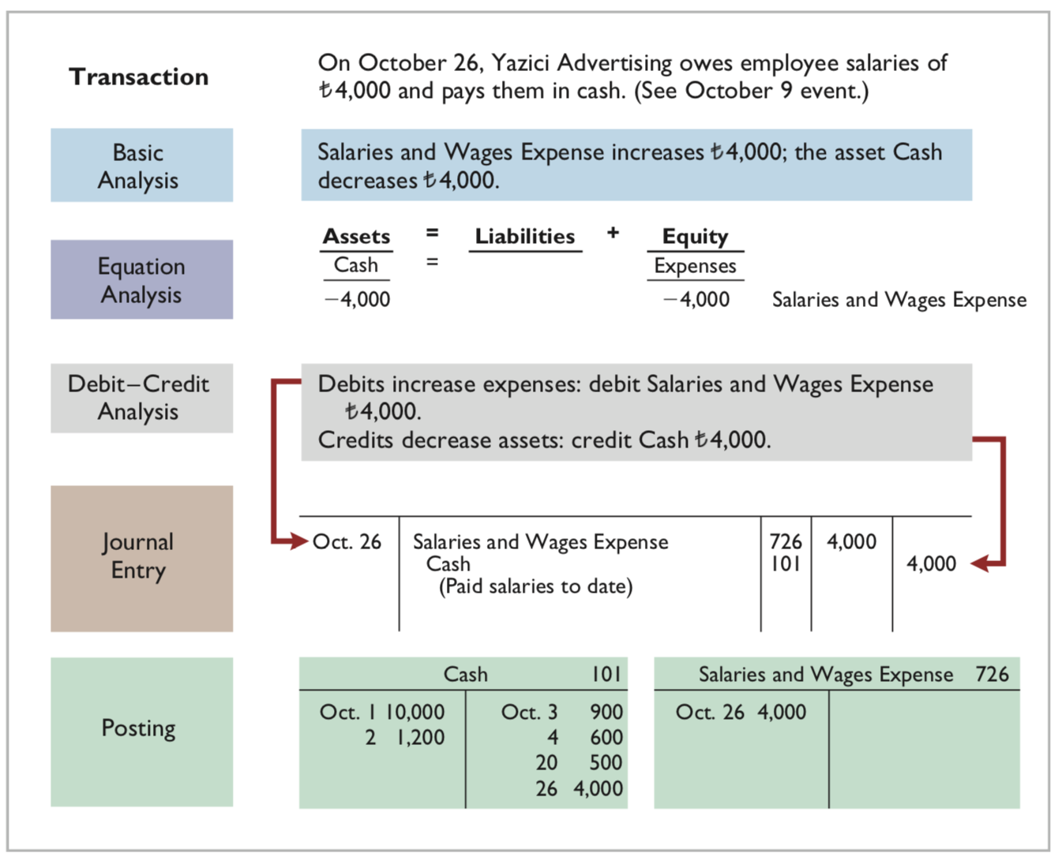

Payment of Salaries
Illustration 2.28: Payment of salaries
L O 3

Slide 49
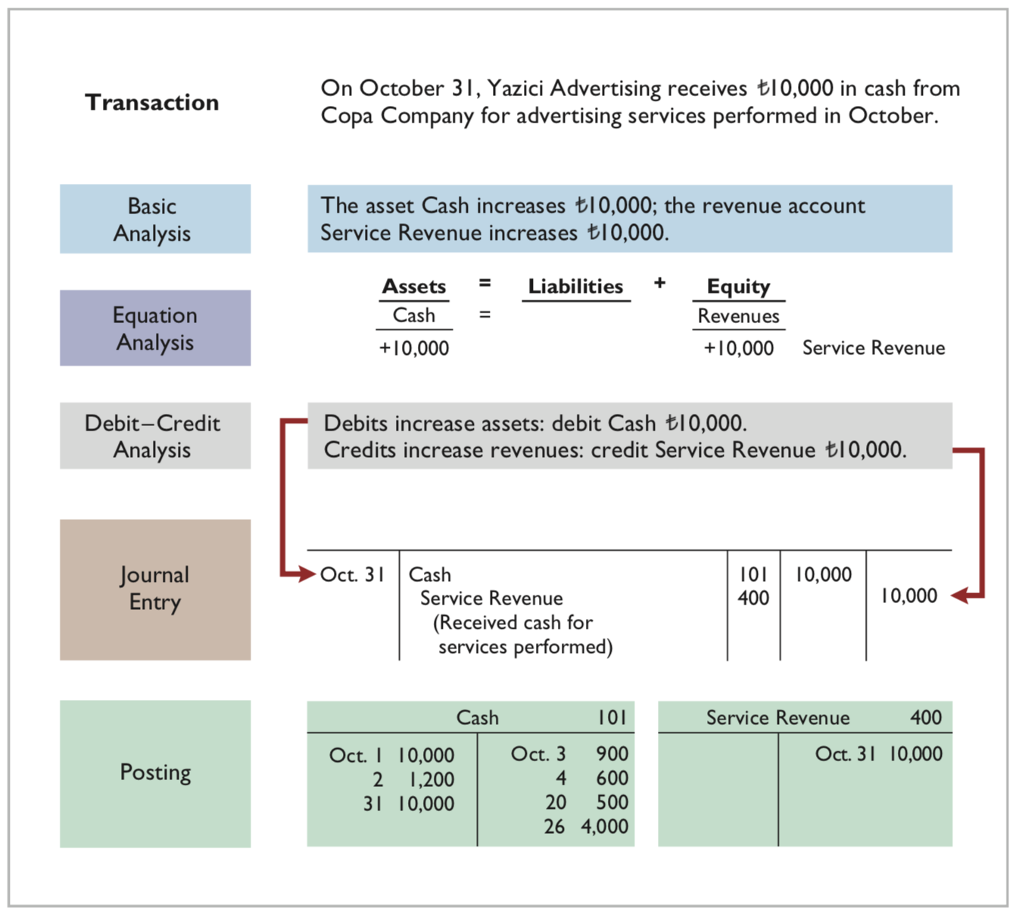
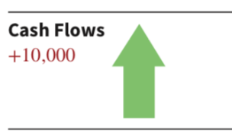
Receipt of Cash for Services
Illustration 2.29: Receipt of cash for services provided
L O 3

Slide 50
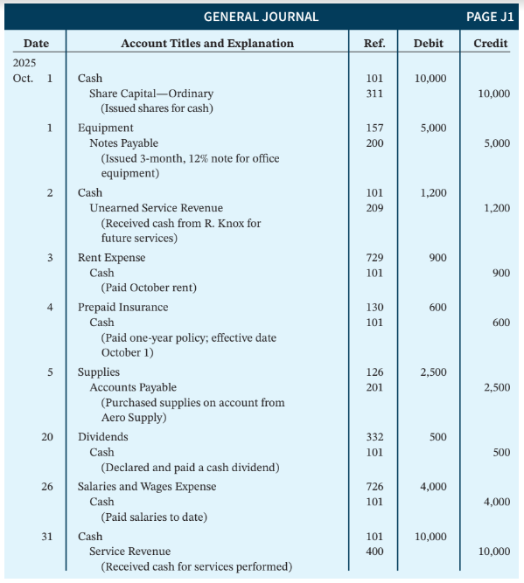
Summary Illustration of Journalizing and Posting
Illustration 2.30: General journal entries
L O 3
Notes:
Each journal entry is used to record individual transations. Written in a chronological order. If we care about changes, we look at the general ledger.

Slide 51
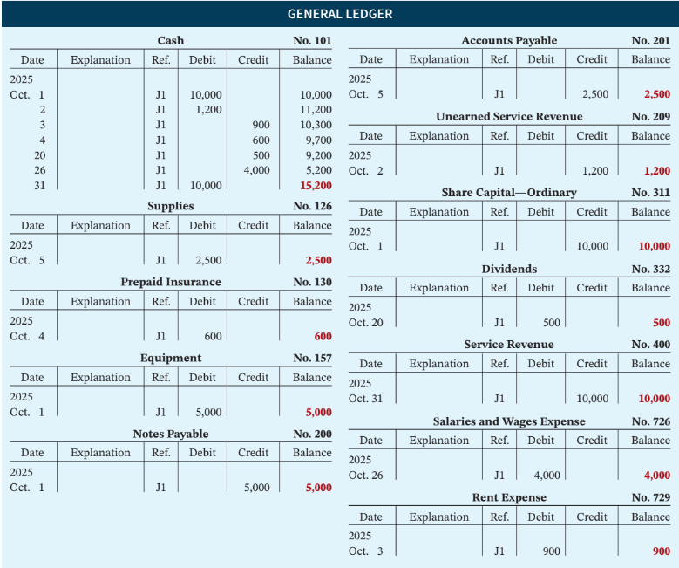
Summary Illustration of General Ledger
Illustration 2.31: General ledger
L O 3
Notes:
Table of changes (general ledger)

Slide 52
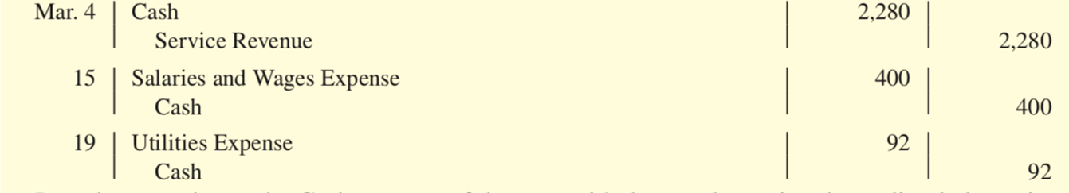
DO IT! 3: Posting
Como SpA recorded the following transactions in a general journal during the month of March:
Post these entries to the Cash account of the general ledger to determine the ending balance in cash. The beginning balance in Cash on March 1 was €600.
L O 3

Slide 53
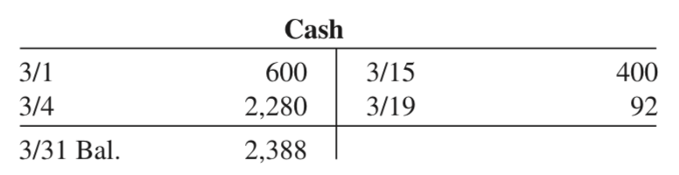
DO IT! 3: Posting – Solution
L O 3

Slide 54
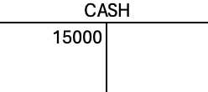
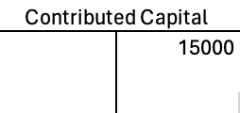
Recap of Monday
Learned how to make journal entries from economic transactions
Cash 15,000
C.C. 15000
Also discussed how to post to ledger

Slide 55
Summary of Debit/Credit Rules
Asset = Liability + Equity → CC & RE
RE = Revenue - Expense - Dividend
L O 1
Notes:
If expenses go up, it decreases equity… so should have opposite sign
If dividends go up, it decreases equity… so should have opposite sign

Slide 56
Learning Objective 4 Prepare a trial balance.
L O 4

Slide 57
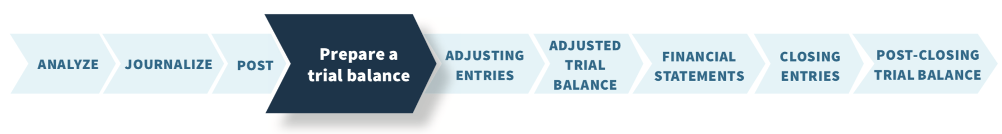
The Trial Balance
Trial balance is a list of accounts and their balances at a given time.
Proves the mathematical equality of debits and credits after posting.
Three steps of preparation:
List the account titles and their balances in the appropriate debit or credit column.
Total the debit and credit columns.
Verify the equality of the two columns.
L O 4
Notes:
What do we do after journalizing and posting? We ask, have we done everything?

Slide 58
Summary Illustration of Journalizing and Posting
Illustration 2.30: General journal entries
L O 3

Slide 59
Summary Illustration of General Ledger
Illustration 2.31: General ledger
(See slides pg. 36-46)
L O 3

Slide 60
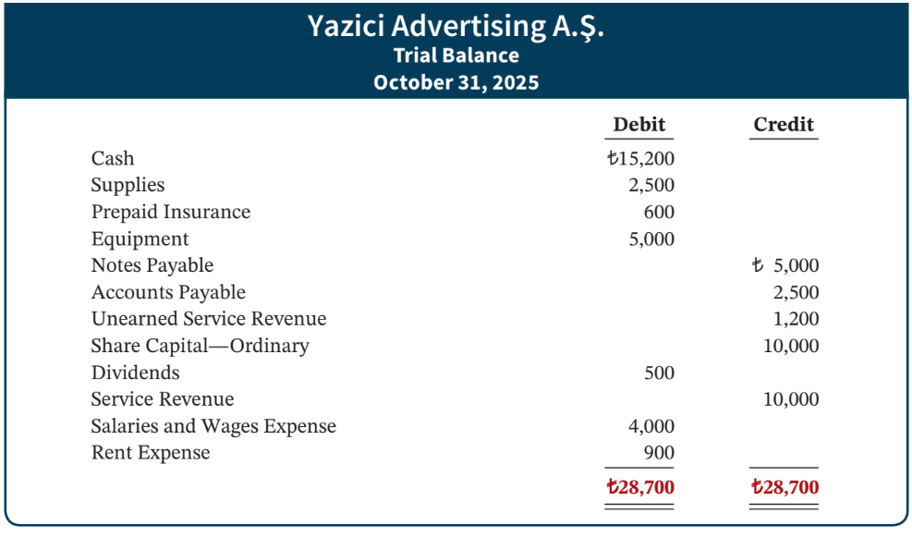
The Trial Balance Illustrated
Illustration 2.32: A trial balance
L O 4
Notes:
Posts final balance in each account. If we put everything together, total debits equal total credits. If it does not equal, something must be wrong! There are also limitations.

Slide 61
Limitations of a Trial Balance
A trial balance may balance even when: 1 - a transaction not journalized. 2 - a correct journal entry not posted. 3 - a journal entry posted twice. 4 - Incorrect accounts used in journalizing or posting. 5 - Offsetting errors made in recording the amount of a transaction.
ETHICS NOTE Error: The result of an unintentional mistake Neither ethical nor unethical
Irregularity: An intentional misstatement Viewed as unethical
L O 4

Slide 62
Currency Signs and Underlining
Currency Signs
Do not appear in journals or ledgers.
Typically used only in the trial balance and the financial statements.
Shown only for the first item and the total in the column.
L O 4

Slide 63






DO IT! 4: Trial Balance
The following accounts come from the ledger of Bali Beach Supply at December 31, 2025.
157 | Equipment | R$88,000
332 | Dividends | 8,000
201 | Accounts Payable | 22,000
726 | Salaries and Wages Expense | 42,000
112 | Accounts Receivable | 4,000
400 | Service Revenue | 95,000
311 | Share Capital —Ordinary | R$20,000
212 | Salaries and Wages Payable | 2,000
200 | Notes Payable (due in 3 Months) | 19,000
732 | Utilities Expense | 3,000
130 | Prepaid Insurance | 6,000
101 | Cash | 7,000
Prepare a trial balance in good form.
L O 4

Slide 64
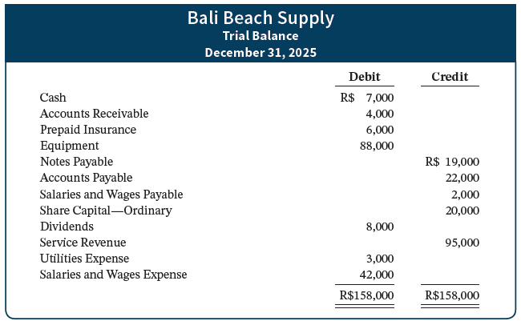
DO IT! 4: Trial Balance – Solution
L O 4

Slide 65
Accounting Cycle
Chapter 2
Chapter 1
During period
End of period
Chapter 3: End of the period
Chapter 4: End of the period
Notes:
Chap 1: How to analyze business transactions
Chap 2,3,4: How to record information and communicate information
Chap 2: How to record info! We have formal way of recording thins. We then make sure we did everything correctly using something called a “Trial balance” at end of period.
Chap 3: If we made any mistakes, now is our chance to fix. If there is additional information that we want to record, we do this. We communicate using financial statements
Chap 4: Then we finalize and get ready for next period.

Slide 66
Financial Accounting
IFRS 5th Edition
Weygandt ● Kimmel
Chapter 3
Adjusting the Accounts
This slide deck contains animations. Please disable animations if they cause issues with your device.
Copyright © John Wiley & Sons, Inc.

Slide 67
Chapter Preview
In Chapter 1, you learned a neat little formula: Net income = Revenues – Expenses.
In Chapter 2, you learned rules for recording revenue and expense transactions.
Guess what?
Things are not really that nice and neat.
In fact, it is often difficult for companies to determine in what time period they should report some revenues and expenses.
In other words, in measuring net income, timing is everything.
Notes:
This is where adjusting entries come in. Adjusting entries are needed to make sure that all revenue and expenses incurred during the period are recorded.

Slide 68
Chapter Outline
LEARNING OBJECTIVES
LO 1 Explain the accrual basis of accounting and the reasons for adjusting entries.
LO 2 Prepare adjusting entries for deferrals.
LO 3 Prepare adjusting entries for accruals.
LO 4 Describe the nature and purpose of an adjusted trial balance.

Slide 69
Learning Objective 1 Explain the accrual basis of accounting and the reasons for adjusting entries.
L O 1

Slide 70
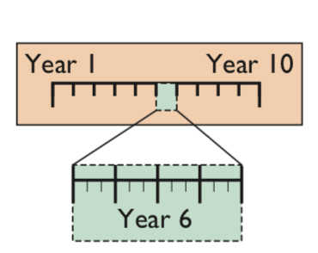
Time Period (Periodicity) Assumption
Accountants divide the economic life of a business into artificial time periods.
L O 1

Slide 71
Fiscal and Calendar Years
Accounting time periods are generally a month, a quarter, or a year.
Monthly and quarterly time periods are called interim periods.
Most large companies must prepare both quarterly and annual financial statements.
Fiscal Year is an accounting time period that is one year in length.
Calendar Year is from January 1 to December 31.
Sometimes a company’s year-end will vary from year to year, resulting in accounting periods of either 52 or 53 weeks.
L O 1

Slide 72
Accrual-Basis Accounting
Transactions are recorded in the periods in which the events occur.
Companies recognize revenues when they perform services (rather than when they receive cash).
Expenses are recognized when incurred (rather than when paid).
Accrual-basis accounting is in accordance with IFRS and the US GAAP.
L O 1
Notes:
Accounting used for reflecting economic activities. Company’s purpose is to generate revenue (maximize profit), when company performs service, we record. We assume cash will be received anyway.

Slide 73
Cash-Basis Accounting
Revenues are recorded when cash is received.
Expenses are recorded when cash is paid.
Cash-basis accounting is NOT in accordance with IFRS or US GAAP.
L O 1

Slide 74
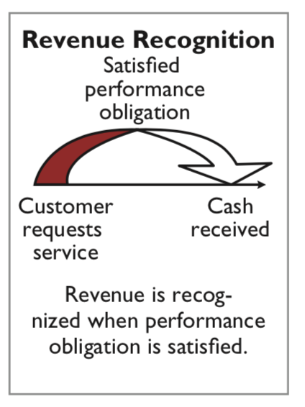
Revenue Recognition Principle
Companies recognize revenue in the accounting period in which the performance obligation is satisfied.
Company satisfies its performance obligation by performing a service or providing a good to a customer.
L O 1

Slide 75
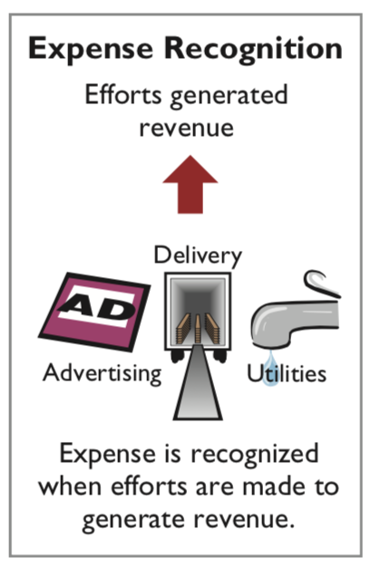
Expense Recognition Principle
L O 1

Slide 76
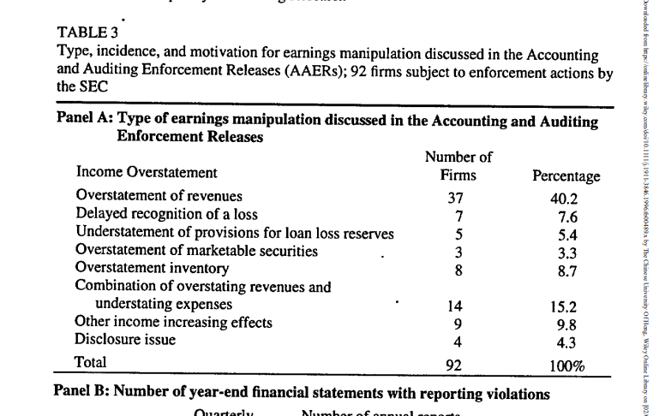

Ethics Insight
Cooking the Books: managers may overstate the revenue or understate the expense
L O 1

Slide 77
Ethics Insight Krispy Kreme
Cooking the Books?
What motivates sales executives and finance and accounting executives to participate in activities that result in inaccurate reporting of revenues?
A: There are several different motives that are at work in these situations. In many cases, the executives involved are greedy. They want to earn bonuses and promotions by reporting more revenue than was earned without actually doing all the work necessary to earn that amount of revenue. Their greed can be fueled by extravagant lifestyles and also sometimes by heavy financial burdens. In other cases, the executives may find themselves faced with unrealistic revenue goals. They overstate revenues to achieve these unrealistic goals to support their company and its leaders, or to avoid failing to meet the goals which could result in the loss of their jobs.
L O 1

Slide 78



Case in point: 瑞幸
Founded in 2017, Luckin Coffee Inc. (“Luckin”) quickly emerged as the fastest growing coffee company in China.

Slide 79
Case in point: 瑞幸
In June 2020, a short report claiming Luckin coffee is engaging in financial fraud began to circulate in the market. Many hedge fund starts to short the company.

Slide 80

Case in point: 瑞幸

Slide 81
Case in point: 瑞幸
We mobilized 92 full-time and 1,418 part-time staff on the ground to run surveillance and record store traffic for 981 store-days covering 100% of the operating hours.
Inflated revenue
Number of items per store per day was inflated by at least 69% in 2019 3Q and 88% in 2019 4Q, supported by 11,260 hours of store traffic video
We gathered 25,843 customer receipts and found that Luckin inflated its net selling price per item by at least RMB 1.23 or 12.3% to artificially sustain the business model
https://www.youtube.com/watch?v=nBmhtM71a7A
L O 1

Slide 82
Case in point: 瑞幸
Aftermath:
Stock price tanked.
Chairman fired.
Fined by the regulator ($180 million USD)
Luckin allegedly materially overstated its reported revenue by approximately 28% for the period ending June 30, 2019, and by 45% for the period ending Sept. 30, 2019, in its publicly disclosed financial statements.
The complaint alleges that during the period of the fraud, Luckin raised more than $864 million from debt and equity investors.
https://www.sec.gov/news/press-release/2020-319
L O 1

Slide 83
Case in point: 瑞幸
Takeaways:
Managers sometimes manipulate their profit for personal benefit i.e., compensation, stock price, raise money.
Such behaviors are unethical and illegal.
Have severe consequences if caught by the investors and regulators.
L O 1

Slide 84
Accrual (Good) accounting practices Adjusting Entries

Slide 85
Adjusting Entries
Adjusting entries ensure that the revenue recognition and expense recognition principles are followed.
Required every time a company prepares financial statements.
Every adjusting entry will include one income statement account and one balance sheet account.
At least one revenue/expense involved
At least one asset/liability involved
L O 1

Slide 86
The Need for Adjusting Entries
Why are adjusting entries required?
Some events are not recorded daily because it is not efficient to do so.
Ex) Using supplies every day. We care about the final balance of supplies at end. It is too inefficient to track usage every day.
Some costs are not recorded during the accounting period because these costs expire with the passage of time rather than as a result of recurring daily transactions.
Ex) Insurance coverage. As time passes, insurance expires. We do not track insurance every day. Just at end of period.
Some items may be unrecorded.
More on next page
L O 1

Slide 87
Types of Adjusting Entries
Deferrals (cash before the revenue/exp):
Prepaid expenses: Expenses paid in cash before they are used or consumed.
Unearned revenues: Cash received before services are performed.
Accruals (cash after the revenue/exp) :
Accrued revenues: Revenues for services performed but not yet received in cash or recorded.
Accrued expenses: Expenses incurred but not yet paid in cash or recorded.
Illustration 3.3 Categories of adjusting entries
L O 1

Slide 88
Learning Objective 2 Prepare adjusting entries for deferrals.
L O 2

Slide 89
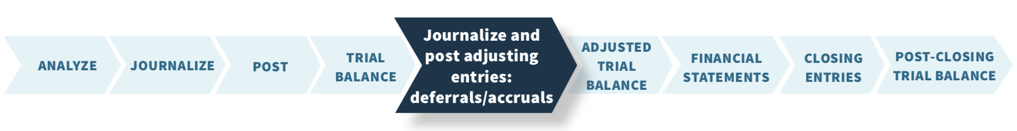
Adjusting Entries for Deferrals
Deferrals are expenses or revenues that are recognized at a date later than the point when cash was originally exchanged.
There are two types:
Prepaid expenses
Unearned revenues
L O 2

Slide 90

Prepaid Expenses
Prepaid expenses are costs that expire either with the passage of time (e.g., rent and insurance) or through use (e.g., supplies).
Prior to adjustment, assets are overstated and expenses are understated.
Illustration 3.5 Adjusting entries for prepaid expenses
L O 2

Slide 91

Supplies
Companies recognize supplies expense at the end of the accounting period – not as the supplies are used.
L O 2

Slide 92
Supplies Adjustment Example
Assume: Yazici Advertising purchased supplies costing ₺2,500 on October 5. Yazici recorded the purchase by increasing (debiting) the asset Supplies. This account shows a balance of ₺2,500 in the October 31 trial balance. An inventory count at the close of business on October 31 reveals that ₺1,000 of supplies are still on hand.
Demonstrate: How do you record the adjustment for supplies?
L O 2

Slide 93

Supplies Adjustment Example – Solution
Illustration 3.6 Adjustment for supplies
L O 2
Notes:
Before recording of the adtjusting entry, is supp expense under or overstated? It is understated by 1500. Because we had not recorded a supplies expense account. Assets are overstated by 1500.

Slide 94

Insurance
The cost of insurance paid in advance is recorded as an increase (debit) in the asset account Prepaid Insurance.
At the financial statement date, companies increase (debit) Insurance Expense and decrease (credit) Prepaid Insurance for the cost of insurance that has expired during the period.
L O 2

Slide 95
Insurance Adjustment Example
Assume: On October 4, Yazici Advertising paid ₺600 for a one-year fire insurance policy. Coverage began on October 1. Yazici recorded the payment by increasing (debiting) Prepaid Insurance.
Demonstrate: How do you record the adjustment for insurance?
L O 2

Slide 96

Insurance Adjustment Example – Solution
Illustration 3.7 Adjustment for insurance
L O 2
Notes:
Expenses are understated by 50.
Assets are overstated by 50.

Slide 97

Depreciation
Depreciation is an allocation concept, not a valuation concept.
Depreciation allocates an asset’s cost to the periods in which it is used.
Depreciation does not attempt to report the actual change in the value of the asset.
L O 2
Notes:
Depr is related to long term assets that have physical substance (equipment, buildings, etc.) When you use the particular asset, its value depreciates.

Slide 98
Depreciation Example
Assume: For Yazici Advertising, depreciation on equipment is ₺480 a year, or ₺40 per month.
Demonstrate: How do you record the adjustment for depreciation?
L O 2

Slide 99
Accounting for Depreciation
Make an accumulated depreciation account
Accumulated Depreciation is a contra account
Contra accounts behave opposite to the account that they are related to
Assets –> Left, Increase; Right, Decrease
Contra-asset → Left, decrease; Right, Increase
If accumulated depreciation account increase, then total book value of the equipment decreases.

Slide 100

Depreciation Example – Solution
Illustration 3.8 Adjustment for depreciation
L O 2

Slide 101
Statement Presentation
Use of a contra account to disclose both the cost of the equipment and total cost expensed to date.
Book value or carrying value: Difference between the cost of any depreciable asset and its related accumulated depreciation.
Equipment | ₺5,000
Less: Accumulated depreciation―equipment | 40
 | ₺4,960
Illustration 3.9 Statement of financial position presentation of accumulated depreciation
L O 2
Notes:
If we do not have accumulated depreciation, we will directly decrease the equipment. On B/S we will only see the final balance. By creating the contra asset account, we see the original cost (5000) and the depreciation expense (40).

Slide 102
Prepaid Expenses Summary
Accounting for Prepaid Expenses
Examples | Reason for Adjustment | Accounts Before Adjustment | Adjusting Entry
Insurance, supplies, advertising, rent, depreciation | Prepaid expenses originally recorded in asset accounts have been used. | Assets overstated. Expenses understated. | Dr. Expenses Cr. Assets or Contra Assets
Illustration 3.10 Accounting for prepaid expenses
L O 2

Slide 103

Unearned Revenues
When companies receive cash before services are performed, they record a liability by increasing (crediting) a liability account called unearned revenues.
Prior to adjustment, liabilities are overstated and revenues are understated.
L O 2

Slide 104

Unearned Revenues Illustrated
Illustration 3.11 Adjusting entries for unearned revenues
L O 2

Slide 105
Unearned Revenue Example
Assume: Yazici Advertising received ₺1,200 on October 2 from R. Knox for advertising services expected to be completed by December 31. Yazici credited the payment to Unearned Service Revenue. This liability account shows a balance of ₺1,200 in the October 31 trial balance. 1200 is for 3 months of service. Company has performed 1 month of service.
Demonstrate: How do you record the adjustment for advertising revenue?
L O 2

Slide 106

Unearned Revenue Example – Solution
Illustration 3.12 Service revenue accounts after adjustment
L O 2

Slide 107
Accounting for Unearned Revenues
Accounting for Unearned Revenues
Examples | Reason for Adjustment | Accounts Before Adjustment | Adjusting Entry
Rent (landlord rent out an apartment), magazine subscriptions, customer deposits for future service | Unearned revenues recorded in liability accounts are now recognized as revenue for services performed. | Liabilities overstated. Revenues understated. | Dr. Liabilities Cr. Revenues
Illustration 3.13 Accounting for unearned revenues
L O 2

Slide 108

Accounting Across the Organization Marks & Spencer plc
Turning Gift Cards into Revenue Suppose that Robert Jones purchases a €100 gift card at Carrefour (FRA) on December 24, 2024, and gives it to his wife, Mary Jones, on December 25, 2024. On January 3, 2025, Mary uses the card to purchase €100 worth of gourmet cheeses. When do you think Carrefour should recognize revenue and why?
A: According to the revenue recognition principle, companies should recognize revenue when the performance obligation is satisfied. In this case, revenue results when Carrefour provides the goods. Thus, when Carrefour receives cash in exchange for the gift card on December 24, 2024, it should recognize a liability, Unearned Sales Revenue, for €100. On January 3, 2025, when Marie Valois exchanges the card for merchandise, Carrefour should recognize revenue and eliminate €100 from the balance in the Unearned Sales Revenue account.
L O 2

Slide 109
Prepaid Expenses Review Question
Adjustments for prepaid expenses:
decrease assets and increase revenues.
decrease expenses and increase assets.
decrease assets and increase expenses.
decrease revenues and increase assets.
L O 2

Slide 110
Prepaid Expenses – Solution
Adjustments for prepaid expenses:
decrease assets and increase revenues.
decrease expenses and increase assets.
decrease assets and increase expenses. (Correct)
decrease revenues and increase assets.
L O 2

Slide 111

DO IT! 2: Adjusting Entries for Deferrals
The ledger of Hammond Deliveries, on March 31, 2025, includes these selected accounts before adjusting entries are prepared:
An analysis of the account shows the following:
Insurance expires at the rate of €100 per month.
Supplies on hand total €800.
The equipment depreciates €200 a month.
During March, services were performed for €4,000 of the unearned service revenue.
Prepare the adjusting entries for the month of March.
L O 2

Slide 112

DO IT! 2: Adjusting Entries for Deferrals – Solution
L O 2

Slide 113
Learning Objective 3 Prepare adjusting entries for accruals.
L O 3

Slide 114

Adjusting Entries for Accruals
Accruals are made to record the following:
Revenues for services performed but not yet recorded at the statement date – accrued revenues or
Expenses incurred but not yet paid or recorded at the statement date – accrued expenses
L O 3

Slide 115

Accrued Revenues
Prior to adjustment, both assets and revenues are understated.
An adjusting entry for accrued revenues results in an increase (a debit) to an asset account and an increase (a credit) to a revenue account.
L O 3

Slide 116

Accrued Revenue Adjusting Entry
Illustration 3.14 Adjusting entries for accrued revenues
L O 3

Slide 117
Accrued Revenue Example
Assume: In October, Yazici Advertising performed services worth ₺200 that were not billed to clients on or before October 31. Because these services were not billed, they were not recorded.
Demonstrate: How do you adjust for accrued revenue?
L O 3

Slide 118

Accrued Revenue Example – Solution
Illustration 3.15 Adjustment for accrued revenue
L O 3

Slide 119
Accrued Revenue Collection Example
Assume: On November 10, Yazici receives cash of ₺200 for the services performed in October.
Demonstrate: How do you record the collection of the receivables?
L O 3

Slide 120

Accrued Revenue Collection – Solution
Nov. 10 | Cash | 200
 | Accounts Receivable |  | 200
 | (To record cash collected on account)
L O 3

Slide 121
Accrued Revenue Summary
Accounting for Accrued Revenues
Examples | Reason for Adjustment | Accounts Before Adjustment | Adjusting Entry
Interest (bank), rent (pay rent after the month passed), services | Services performed but not yet received in cash or recorded. | Assets understated. Revenues understated. | Dr. Assets (AR) Cr. Revenues
Illustration 3.16 Accounting for accrued revenues
L O 3

Slide 122

Accrued Expenses
Prior to adjustment, both liabilities and expenses are understated.
An adjusting entry for accrued expenses results in an increase (a debit) to an expense account and an increase (a credit) to a liability account.
Illustration 3.17 Adjusting entries for accrued expenses
L O 3

Slide 123
Accrued Interest Example
Assume: Yazici Advertising signed a three-month note payable in the amount of ₺5,000 on October 1. The note requires Yazici to pay interest at an annual rate of 12%.
Demonstrate:
How do you determine the interest to be recorded?
How do you create the adjustment for accrued interest for the month of October?
L O 3

Slide 124
Accrued Interest – Solution Part 1
Face Value of Note | × | Annual Interest Rate | × | Time in Terms of One Year | = | Interest
₺5,000 | × | 12% | × |  | = | ₺50
Illustration 3.18 Formula for computing interest
L O 3

Slide 125

Accrued Interest – Solution Part 2
Illustration 3.19 Adjustment for accrued interest
L O 3

Slide 126

Accrued Salaries and Wages
Companies pay for some types of expenses, such as employee salaries and wages, after the services have been performed.
Illustration 3.20 Calendar showing Yazici’s pay periods
L O 3

Slide 127
Salaries and Wages Example
Assume: At October 31, the salaries and wages for these three days represent an accrued expense and a related liability to Yazici. The employees receive total salaries and wages of ₺2,000 for a five-day work week, or ₺400 per day. They have been paid on October 26. Thus, accrued salaries and wages at October 31 are ₺1,200 (₺400 × 3).
Demonstrate: How do you create the adjustment for accrued salaries and wages?
L O 3

Slide 128

Salaries and Wages Example – Solution
Illustration 3.21 Adjustment for accrued salaries and wages
L O 3

Slide 129
Salary Payment Example
Assume: Yazici pays salaries and wages every two weeks. Consequently, the next payday is November 9, when the company will again pay total salaries and wages of ₺4,000. The payment consists of ₺1,200 of salaries and wages payable at October 31 plus ₺2,800 of salaries and wages expense for November (7 working days, as shown in the November calendar × ₺400).
Demonstrate: What entry does Yazici make on November 9?
L O 3

Slide 130

Salary Payment Example – Solution
Nov. 9 | Salaries and Wages Payable | 1,200
 | Salaries and Wages Expense | 2,800
 | Cash (To record November 9 payroll) |  | 4,000
L O 3

Slide 131
Accrued Expenses Summary
Accounting for Accrued Expenses
Examples | Reason for Adjustment | Accounts Before Adjustment | Adjusting Entry
Interest, salaries | Expenses have been incurred but not yet paid in cash or recorded. | Expenses understated. Liabilities understated. | Dr. Expenses Cr. Liabilities
Illustration 3.22 Accounting for accrued expenses
L O 3

Slide 132
Adjusting Entries Reminders
Adjusting entries should not involve debits or credits to Cash.
Evaluate whether the adjustment makes sense. For example, an adjustment to recognize supplies used should increase Supplies Expense.
Double-check all computations.
Each adjusting entry affects one statement of financial position account and one income statement account.
L O 3

Slide 133
Summary of Basic Relationships
Type of Adjustment | Accounts Before Adjustment | Adjusting Entry
Prepaid Expenses | Assets overstated. Expenses understated. | Dr. Expenses Cr. Assets or Contra Assets
Unearned revenues | Liabilities overstated. Revenues understated. | Dr. Liabilities Cr. Revenues
Accrued revenues | Assets understated. Revenues understated. | Dr. Assets Cr. Revenues
Accrued expenses | Expenses understated. Liabilities understated. | Dr. Expenses Cr. Liabilities
Illustration 3.23 Summary of adjusting entries
L O 3

Slide 134

General Journal Example
Illustration 3.24 General journal showing adjusting entries
L O 3

Slide 135

General Ledger Example
Illustration 3.25 (Partial) General ledger after adjustment
L O 3

Slide 136
DO IT! 3: Adjusting Entries for Accruals
Mahindra Computer Services began operations on August 1, 2025. At the end of August 2025, management prepares monthly financial statements. The following information relates to August (amounts in thousands).
At August 31, the company owed its employees ₹800 in salaries and wages that will be paid on September 1.
On August 1, the company borrowed ₹30,000 from a local bank on a 15-year mortgage. The annual interest rate is 10%.
Revenue for services performed but unrecorded for August totaled ₹1,100.
Prepare the adjusting entries needed at August 31, 2025.
L O 3

Slide 137

DO IT! 3: Adjusting Entries – Solution
L O 3

Slide 138
Learning Objective 4 Describe the nature and purpose of an adjusted trial balance.
L O 4

Slide 139

Adjusted Trial Balance and Financial Statements
Adjusted trial balance:
Shows the balance of all accounts, including those adjusted.
Proves the equality of the total debit balances and the total credit balances in the ledger after all adjustments.
Primary basis for the preparation of financial statements.
L O 4

Slide 140

Preparing the Adjusted Trial Balance
Illustration 3.26 Adjusted trial balance
L O 4

Slide 141

Preparing Financial Statements (1/2)
Illustration 3.27 Preparation of the income statement and retained earnings statement from the adjusted trial balance
L O 4

Slide 142

Preparing Financial Statements (2/2)
Illustration 3.28 Preparation of the statement of financial position from the adjusted trial balance.
L O 4

Slide 143

DO IT! 4: Trial Balance
Kang Company was organized on April 1, 2025. The company prepares quarterly financial statements. The adjusted trial balance amounts at June 30 are shown below (amounts in millions).
Determine the net income for the quarter April 1 to June 30.
Determine the total assets and total liabilities at June 30, 2025, for Kang Company.
Determine the amount of retained earnings at June 30, 2025.
L O 4

Slide 144

DO IT! 4: Trial Balance – Solution Part 1
The net income is determined by adding revenues and subtracting expenses. The net income is computed as follows (in millions).
L O 4

Slide 145



DO IT! 4: Trial Balance – Solution Part 2
Total assets and liabilities are computed as follows (in millions).
L O 4

Slide 146
Learning Objective 6 Financial reporting concepts.
L O 6

Slide 147
What is high quality financial reporting?
Quality: | It means:
Comparability | Different companies use the same accounting principles, and A company uses the same accounting principles and methods from year to year (consistency).
Verifiability | Independent observers, using the same methods, obtain similar results.
Timeliness | It is necessary for accounting information to be relevant.
Understandability | Information is presented in a clear and concise fashion, so that reasonably informed users of that information can interpret it and comprehend its meaning.
L O 6

Slide 148

Assumptions in Financial Reporting (1/2)
Illustration 3B.2 (Partial) Key assumptions in financial reporting
L O 6

Slide 149

Assumptions in Financial Reporting (2/2)
Illustration 3B.2 (Partial) Key assumptions in financial reporting
L O 6

Slide 150
DO IT! 1: Timing Concepts
Below is a list of concepts in the left column, with a description of the concept in the right column. There are more descriptions provided than concepts. Match the description to the concept.
___Accrual-basis accounting.
___Calendar year.
___Time period assumption.
___Expense recognition principle.
Monthly and quarterly time periods.
Efforts (expenses) should be recognized in the period in which a company uses assets or incurs liabilities to generate results (revenues).
Accountants divide the economic life of a business into artificial time periods.
Companies record revenues when they receive cash and record expenses when they pay out cash.
An accounting time period that starts on January 1 and ends on December 31.
Companies record transactions in the period in which the events occur.
L O 1

Slide 151
DO IT! 1: Timing Concepts – Solution
f
e
c
b
L O 1

